Slide 1
MET Significance Study
Julia Hinds
CMSE 802 - 001
Michigan State University
April 26th, 2022

Slide 2
Background
What is particle physics?
“Like giant toddlers … smashing things together to see what comes out”
-Anonymous

Slide 3
Background
The European Organization for Nuclear Research (CERN), the Large Hadron Collider (LHC), and ATLAS (A Toroidal LHC ApparatuS) experiment
Forbes Magazine. https://www.forbes.com/sites/startswithabang/2021/09/07/the-3-reasons-why-cerns-large-hadron-collider-cant-make-particles-go-faster/?sh=3e360abf2aae [Accessed October 6, 2021].
UCI Energy Blogs. https://sites.uci.edu/energyobserver/2012/11/26/introduction-to-the-atlas-detector-at-the-lhc/ [Accessed October 6, 2021].
Notes:
As big as notre dame and weighs as much as the Eiffel tower

Slide 4
Motivation
Improve cuts which improve results!
Cuts
Results
Raw Data
UCI Energy Blogs. https://sites.uci.edu/energyobserver/2012/11/26/introduction-to-the-atlas-detector-at-the-lhc/ [Accessed October 6, 2021].
Notes:
As big as notre dame and weighs as much as the Eiffel tower

Slide 5
Motivation
Improve cuts which improve results!
Cuts
Results
Raw Data
My work applies here!
UCI Energy Blogs. https://sites.uci.edu/energyobserver/2012/11/26/introduction-to-the-atlas-detector-at-the-lhc/ [Accessed October 6, 2021].
Notes:
As big as notre dame and weighs as much as the Eiffel tower

Slide 6
Motivation
What would improved sensitivity look like?
Example: previous analysis results
https://arxiv.org/abs/2004.14636
Notes:
Among the questions listed, my work has the potential to help these two questions

Slide 7
Motivation
My goal is to apply cuts to the MET Significance (one of the kinematic variables) to try to optimize the signal significance.
Introducing a new parameter to clean up end results
Notes:
In order for us to be able to detect new physics in the ATLAS detector (which is a rare process - showing up as a small signal, or "bump", in our data), we want to minimize the background while maximizing the signal making it easier fo us to identify. We have several variables that describe an event or collision in the detector, and the signal would have a subtly different distribution in these variables to the background (which sometimes have to be teased out). Thus, optimising the selection of events which have certain restrictions (i.e. cuts) to some variables, could enhance the number of signal events selected compared to the background.

Slide 8
Code and Documentation
Languages and packages
C++, ROOT, and Python were used
Matplotlib (Jupyter Notebook) and ROOT histograms were used for visualization
Analysis Framework
METSignificanceStudy
https://gitlab.msu.edu/hindsju1/metsignificancestudy
Used to study the METSignificance variable and how the cuts impact the significance
Code developed in parallel for this project
Notes:
CxAOD Reader Framework
ROOT ntuple production
https://gitlab.cern.ch/CxAODFramework/CxAODReader_VVSemileptonic/-/tree/dev-hinds
Used to produce VV and VH samples for analysis (precursor to project)
In order for us to be able to detect new physics in the ATLAS detector (which is a rare process - showing up as a small signal, or "bump", in our data), we want to minimize the background while maximizing the signal making it easier fo us to identify. We have several variables that describe an event or collision in the detector, and the signal would have a subtly different distribution in these variables to the background (which sometimes have to be teased out). Thus, optimising the selection of events which have certain restrictions (i.e. cuts) to some variables, could enhance the number of signal events selected compared to the background.

Slide 9
Code and Documentation
Analysis Framework
CutFlowProduction.C
Code that produces the cut flow of the analysis
The cut flow is a representation of how many events pass each sequential cut
VV_VH_distributions_plotting.ipynb
Jupyter Notebook that plots 1D and 2D kinematic distributions
Used primarily for visualizations
METSigStudy.C
Main calculation of significance done
Plots the significance vs METSig cut for different signal masses
Notes:
In order for us to be able to detect new physics in the ATLAS detector (which is a rare process - showing up as a small signal, or "bump", in our data), we want to minimize the background while maximizing the signal making it easier fo us to identify. We have several variables that describe an event or collision in the detector, and the signal would have a subtly different distribution in these variables to the background (which sometimes have to be teased out). Thus, optimising the selection of events which have certain restrictions (i.e. cuts) to some variables, could enhance the number of signal events selected compared to the background.

Slide 10
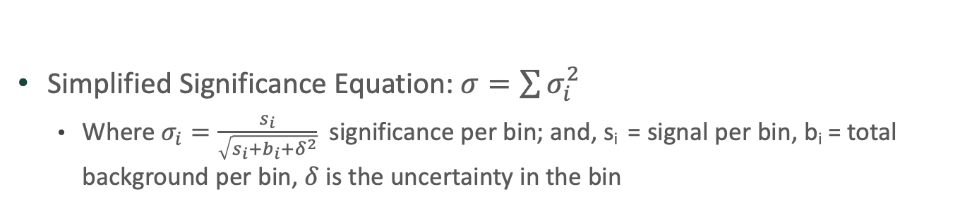
Significance Calculation
Simplified Significance Equation: $σ=\sum{σ_{i}^{2}}$
Where $σ_{i}=\frac{s_{i}}{\sqrt{s_{i}+b_{i}+δ^{2}}}$ significance per bin; and, s_{i} = signal per bin, b_{i} = total background per bin, $δ$ is the uncertainty in the bin
Notes:
In order for us to be able to detect new physics in the ATLAS detector (which is a rare process - showing up as a small signal, or "bump", in our data), we want to minimize the background while maximizing the signal making it easier fo us to identify. We have several variables that describe an event or collision in the detector, and the signal would have a subtly different distribution in these variables to the background (which sometimes have to be teased out). Thus, optimising the selection of events which have certain restrictions (i.e. cuts) to some variables, could enhance the number of signal events selected compared to the background.

Slide 11
“Unit testing”
Unit testing for ROOT and C++ is very difficult – created own “pseudo-tests”
Tested edge cases (empty histograms being passed, signal histogram not passed, etc.)
Tested values for specific cases
Used generic ROOT histograms and calculated the significance by hand and compared
Pi
Pi/2
Gaussian

Slide 12
Results – VV PFlow+UFO HVT LP no-tag

Slide 13
Results – VV PFlow+UFO HVT LP no-tag
Z+jets only

Slide 14
Results – VV PFlow+UFO HVT LP no-tag
METSig cut = 0

Slide 15
Results – VV PFlow+UFO HVT LP no-tag

Slide 16
Conclusion and Next Steps
Developed code to analyze MET Significance cuts affect on the signal significance
Possible improved sensitivity between a METSig cut of 15 – 25
Next Steps,
Produce finer binning to find an approximate cut
Apply ML to see if it can find an optimal cut with all signal masses
Replace previous cuts with this improved cut to see if sensitivity is gained

Slide 17
Questions?

Slide 18
Back up

Slide 19
Background
The European Organization for Nuclear Research (CERN), the Large Hadron Collider (LHC), and ATLAS (A Toroidal LHC ApparatuS) experiment
CERN & LHC
Largest particle physics laboratory in the world
27 kilometer circumference
4 major detectors (ATLAS, CMS, ALICE, LHCb)
No. collisions per second: 1 billion
ATLAS
General purpose detector at the LHC
45 meters in length
25 meters in diameter
Weighs over 7000 tons
100 meters below ground
Forbes Magazine. https://www.forbes.com/sites/startswithabang/2021/09/07/the-3-reasons-why-cerns-large-hadron-collider-cant-make-particles-go-faster/?sh=3e360abf2aae [Accessed October 6, 2021].
UCI Energy Blogs. https://sites.uci.edu/energyobserver/2012/11/26/introduction-to-the-atlas-detector-at-the-lhc/ [Accessed October 6, 2021].
Notes:
As big as notre dame and weighs as much as the Eiffel tower

Slide 20
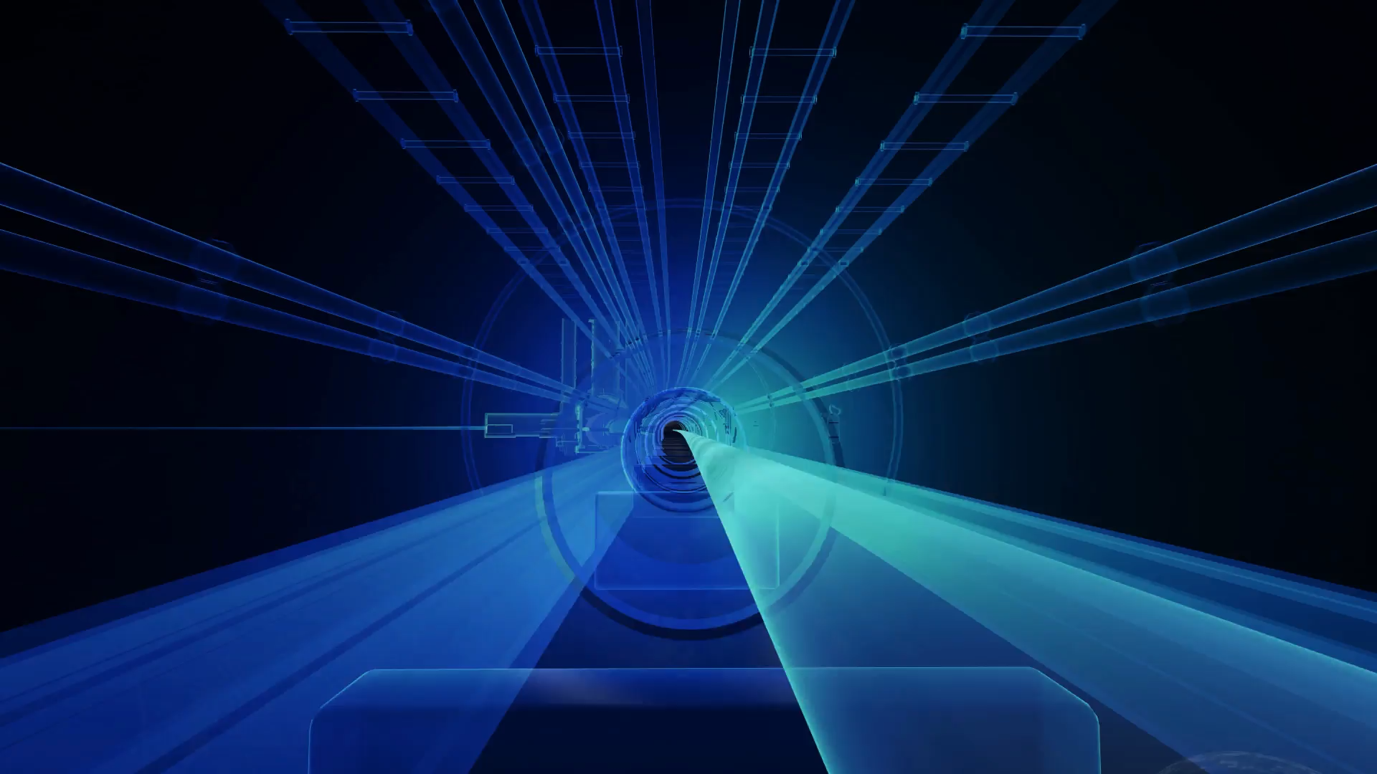
Background
ATLAS (A Toroidal LHC ApparatuS) experiment
Insert animation
Notes:
Each square is the detectors response to this collision

Slide 21
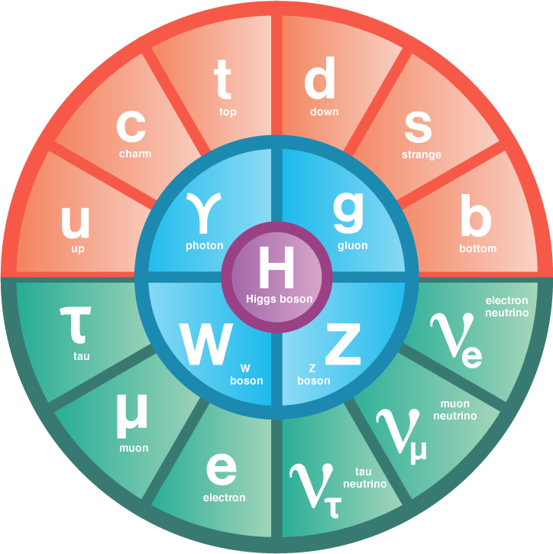
Background
Standard model (SM) theory
Theory that describes all of the fundamental particles that we have observed so far
Can be categorize and describe interactions
Need for beyond standard model (BSM)
Are we missing any particles?
Is there a gravity force carrier?
How does dark matter fit in?
Is there anything more fundamental?
Is there a point where we have all the forces unified together?
.
.
.
Quarks
Leptons
Bosons
Symmetry Magazine. https://www.symmetrymagazine.org/standard-model/ [Accessed October 6, 2021].
Notes:
Like the periodic table for fundamental particles
We’re like 100 percent sure the SM is not the right theory because it doesn’t contain a lot of things

Slide 22
Background
These are the questions that motivate us!
Standard model
Like the periodic table for fundamental particles
Questions you could ask
Are we missing any particles?
Is there a gravity force carrier?
How does dark matter fit in?
Is there anything more fundamental?
Is there a point where we have all the forces unified together?
.
.
.
Quarks
Leptons
Bosons
Symmetry Magazine. https://www.symmetrymagazine.org/standard-model/ [Accessed October 6, 2021].

Slide 23
Motivation
My questions: Is there a point where we have all the SM forces unified together? Is there a gravity force carrier?
To answer this, we’ll need new physics models (experimental inputs)
Grand Unified Theory
Quantum gravity/Graviton
We need experimental input to understand these models better
Maybe exclude some of the theories (need measurements to determine which theories are wild, and which ones are wild and plausible!)
Important to note, even if we don’t find something, that can still help exclude certain parts of the theory!
Notes:
Need new theoretical models and these can hopefully help us
Even if we don’t find something, that can still help exclude certain parts of the theory
We have theories, and extensions of a theory, and my work may be able to help give some inputs to the theory

Slide 24
Motivation
Question: Is there a point where we have all the SM forces unified together?
Grand Unified Theory (GUT)
A model where at high energies, the electromagnetic, weak, and strong forces merge into a single force
Us now
(~10⁻¹³ GeV)
~100 GeV
~10¹⁴ GeV
Notes:
Our energy scale (low energy) – observe all forces independently
At higher energies, we have observed some of the forces merge
Why do these forces merge and why do you think they will merge? Running Coupling constant
In theory gravity might unify to get Theory of Everything, but we don’t know the anything about it much less the coupling constant
The term graviton was originally coined in 1934 by Soviet physicists Dmitrii Blokhintsev and F.M. Gal'Perini
LHC 13 TeV = 13000 GeV

Slide 25
Motivation
Question: Is there a point where we have all the SM forces unified together?
Grand Unified Theory (GUT)
A model where at high energies, the electromagnetic, weak, and strong forces merge into a single force
Observing these new particles could provide evidence of unification at a higher energy
Standard Model Particles
(𝛾,g,W^{+/-},Z⁰)
Extra particles
(Z’,W’)
GUT
+
Notes:
In order for this theory to be plausible, it must (at bare minimum) map back to the SM particles at low energies
We start from some structure, which defines a largrangian, that defines all of the particles and force carries that exist at some (high) energy scale
We need to map these models back to low energies – and need to match the low energy region (SM particles) – we cannot have a GUT that does not contain the SM particles somehow
When we do this, some of the coupling constants become energy dependent (so some of them go away)
These extra particles come from effective vertices or effective interactions (mayo or may not be real vertices)
These extra particles come from higher theory compared to the SM so there may be some extra particles
My research (as you will see) is searching for Z’ and W’ particles
You create a GUT and some of them MAY lead to extra particles (class of theories) – can weed out different theories
The term graviton was originally coined in 1934 by Soviet physicists Dmitrii Blokhintsev and F.M. Gal'Perini

Slide 26
Motivation
Question: Is there a gravity force carrier?
Quantum Gravity/Graviton
Hypothetical spin-2 particle that mediates the gravitational force
But first, let’s talk about dimensionality…
Notes:
Most models (and evidence) leans towards spin-2
The term graviton was originally coined in 1934 by Soviet physicists Dmitrii Blokhintsev and F.M. Gal'Perini

Slide 27
Motivation
Question: Is there a gravity force carrier?
Quantum Gravity/Graviton
Hypothetical spin-2 particle that mediates the gravitational force
But first, let’s talk about dimensionality…
Vecteezy. https://www.vecteezy.com/vector-art/152799-tightrope-walker-over-city-buildings [Accessed October 13 2021].
Notes:
The term graviton was originally coined in 1934 by Soviet physicists Dmitrii Blokhintsev and F.M. Gal'Perini

Slide 28
Motivation
Question: Is there a gravity force carrier?
Quantum Gravity/Graviton
Hypothetical spin-2 particle that mediates the gravitational force
But first, let’s talk about dimensionality…
Vecteezy. https://www.vecteezy.com/vector-art/152799-tightrope-walker-over-city-buildings [Accessed October 13 2021].
Shutterstock. https://www.shutterstock.com/image-photo/ant-on-tightrope-1445223776 [Accessed October 13 2021].
Notes:
Extra pocket of dimensionality layered on top of our 3d world
Same connection to probing small length scales at CERN
The term graviton was originally coined in 1934 by Soviet physicists Dmitrii Blokhintsev and F.M. Gal'Perini

Slide 29
Motivation
Question: Is there a gravity force carrier?
Quantum Gravity/Graviton
Hypothetical spin-2 particle that mediates the gravitational force
But first, let’s talk about dimensionality…
Vecteezy. https://www.vecteezy.com/vector-art/152799-tightrope-walker-over-city-buildings [Accessed October 13 2021].
Shutterstock. https://www.shutterstock.com/image-photo/ant-on-tightrope-1445223776 [Accessed October 13 2021].
Scribal Multiverse. http://www.scribalmultiverse.com/brane-worlds-and-higher-dimensions/ [Accessed October 13 2021].
Notes:
Extra pocket of dimensionality layered on top of our 3d world
The term graviton was originally coined in 1934 by Soviet physicists Dmitrii Blokhintsev and F.M. Gal'Perini
a brane is a physical object that generalizes the notion of a point particle to higher dimensions. Branes are dynamical objects which can propagate through spacetime according to the rules of quantum mechanics. They have mass and can have other attributes such as charge.

Slide 30
Motivation
How do you “detect” this new physics?
Collisions at the LHC
Data Collected
“Usable” Data
Analysis

Slide 31
Motivation
How do you “detect” this new physics?
Collisions at the LHC
Data Collected
“Usable” Data
Analysis
Where I come in

Slide 32
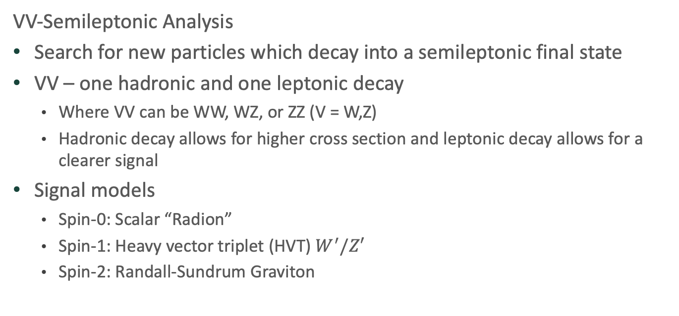
Motivation
VV-Semileptonic Analysis
Search for new particles which decay into a semileptonic final state
VV – one hadronic and one leptonic decay
Where VV can be WW, WZ, or ZZ (V = W,Z)
Hadronic decay allows for higher cross section and leptonic decay allows for a clearer signal
Signal models
Spin-0: Scalar “Radion”
Spin-1: Heavy vector triplet (HVT) $W^{′}/Z′$
Spin-2: Randall-Sundrum Graviton
Production
Gluon-gluon fusion (ggF)
Quark-quark annihilation (Drell-Yan)
Vector-boson fusion (VBF)
Notes:
Vector-vector Boson semileptonic
Fully leptonic channel has very clear signal but very low cross section
Pure hadronic has very high cross section but there is poor signal resolution (quarks hadronized which is messy in the detector)
Rob (post-doc) is the coordinator of analysis
Three different signal models labeled by the spin of the outgoing vectors
Also have to take into account the production (or way it was produced)
RS Radion, HVT, RS graviton
RS = Randall-Sundrum: model that describe the world in terms of a warped-geometry higher dimensional universe
Hashed circled represent direct or effective coupling

Slide 33
Motivation
VV-Semileptonic Analysis
Search for new particles which decay into a semileptonic final state
VV – one hadronic and one leptonic decay
Where VV can be WW, WZ, or ZZ (V = W,Z)
Hadronic decay allows for higher cross section and leptonic decay allows for a clearer signal
Signal models
Spin-0: Scalar “Radion”
Spin-1: Heavy vector triplet (HVT) $W^{′}/Z′$
Spin-2: Randall-Sundrum Graviton
Production
Gluon-gluon fusion (ggF)
Quark-quark annihilation (Drell-Yan)
Vector-boson fusion (VBF)
Main focus for now
Notes:
RS Radion, HVT, RS graviton
RS = Randall-Sundrum: model that describe the world in terms of a warped-geometry higher dimensional universe
Hashed circled represent direct or effective coupling

Slide 34
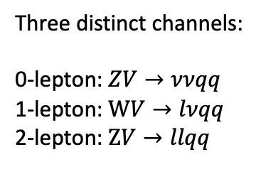
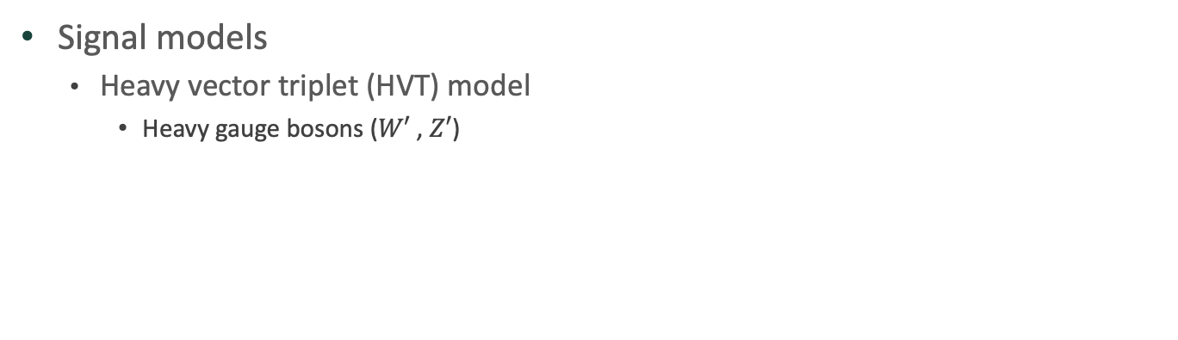
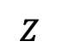
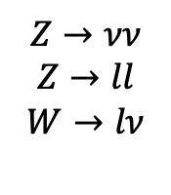
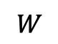
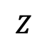
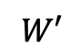
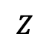
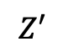
Motivation
Signal models
Heavy vector triplet (HVT) model
Heavy gauge bosons ($W′$ , $Z′$)
Three distinct channels:
0-lepton: $ZV→ννqq$
1-lepton: $WV→lνqq$
2-lepton: $ZV→llqq$
$$W$$
$$Z$$
$$Z→νν$$
$$Z→ll$$
$$W→lν$$
$$W′$$
$$Z′$$
$$Z$$
$$Z$$
Notes:
Heavy vector decays into two light vectors
RS Radion, HVT, RS graviton
RS = Randall-Sundrum: model that describe the world in terms of a warped-geometry higher dimensional universe
Hashed circled represent direct or effective coupling

Slide 35
Motivation
VV-Semileptonic Analysis
Search for new particles which decay into a semileptonic final state
VV – one hadronic and one leptonic decay
Where VV can be WW, WZ, or ZZ (V = W,Z)
Hadronic decay allows for higher cross section and leptonic decay allows for a clearer signal
Signal models
Spin-0: Scalar “Radion”
Spin-1: Heavy vector triplet (HVT) $W^{′}/Z′$
Spin-2: Randall-Sundrum Graviton
Production
Gluon-gluon fusion (ggF)
Quark-quark annihilation (Drell-Yan)
Vector-boson fusion (VBF)
Notes:
RS Radion, HVT, RS graviton
RS = Randall-Sundrum: model that describe the world in terms of a warped-geometry higher dimensional universe
Hashed circled represent direct or effective coupling

Slide 36
Motivation
VV-Semileptonic Analysis
gluon-gluon fusion (ggF)
Drell-Yan (DY)
Vector-boson fusion (VBF)
Notes:
Which is best production method for my analysis
A: two-fold. 1st, small coupling vertices (one with the fewest vertices has better cross section). Drell -Yan at LHC is suppressed because protons have no anti-quarks. So drell-yan has smaller cross section because probability of having gluons and regular quarks is higher than getting anti-quarks
Heavy resonances partially decays diboson resonances (which then decays to leptons)
This is done by ggF, the Drell-Yan process, or VBF
One way we can see GUT is with ggF
VBF has signal created by and decays to bosons – unique to dibosons – if only decays to bosons, we’re in a unique position to see it
Hashed circled represent direct or effective coupling

Slide 37
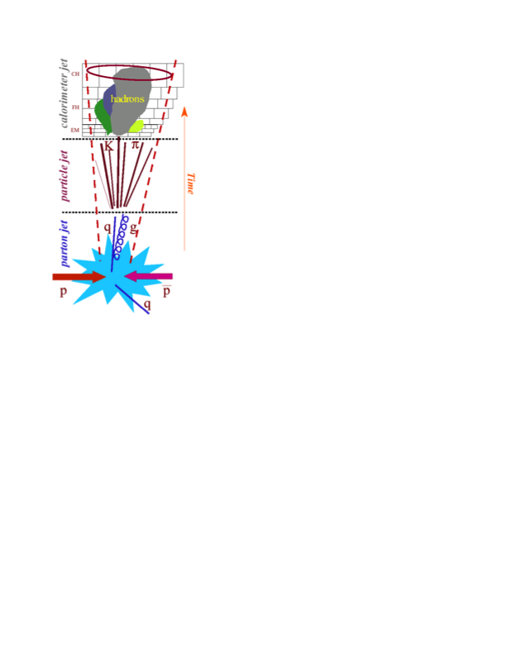
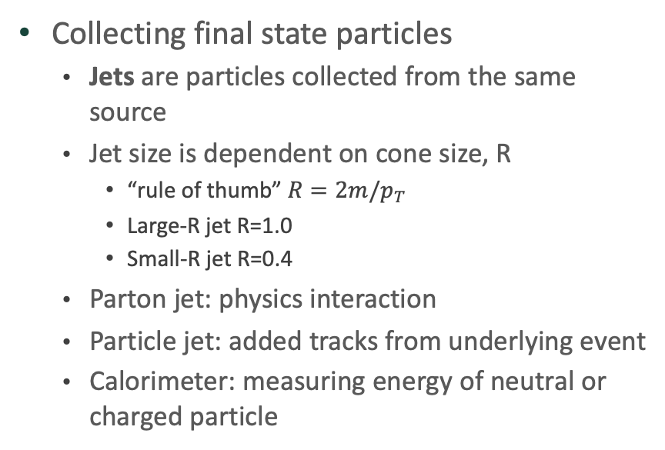
Definitions
R
Collecting final state particles
Jets are particles collected from the same source
Jet size is dependent on cone size, R
“rule of thumb” $R=2m/p_{T}$
Large-R jet R=1.0
Small-R jet R=0.4
Parton jet: physics interaction
Particle jet: added tracks from underlying event
Calorimeter: measuring energy of neutral or charged particle
Loch, Peter. US-ATLAS mini-course on Jets. https://indico.cern.ch/event/1054786/ [Accessed October 1, 2021].
Notes:
Identifying quarks in the detector
Quarks hadronized – because of the nature of the strong force (and confinement) – we can’t observe bare quarks, we can only observe hadrons
At the collision point, we do have bare quarks. But then they very quickly start to hadonize and since they are energenic they keep spawning gluons – so we observe this “shower” effect
For leptons, we only see charged leptons – so we see a charged track (easy because we just see one track), just tricky because of all of the neutrinos
Why are leptons clear in signal and why are jets hard? And why do we have jets for hadrons?
0-lep channel: two jets (shouldn’t be too messy) and no tracks (because two neutrinos – not charged so no tracks)
Cone of size 𝑅 contains decay products of particle with mass m
ΔR = sqrt((Δη)^2 + (Δɸ)^2))

Slide 38
Definitions
Resolved
Two small R-jets
Merged
One large R-jet
Only merged used here
Missing E_{T} (MET or E_{T}^{miss})
Reconstructed by negative sum of the all physics objects and ID tracks not associated with them in the transverse direction (should sum to zero)
Neutrinos don’t show up in detector, so when look at energy conservation there will be energy missing, i.e. neutrino energy
Notes:
Depending on physics intent, different types of jets are useful
0-lep is boosted region
Small-R jets: R = 0.4 Used for “standard” QCD jets. Jet contain a light quarks/gluons
Large-R jets: R = 1.0 Used for boosted topologies. Jet contain hadronically decaying particle W/Z/H/top/X

Slide 39
Definitions
Purity
High (HP) or Low (LP) depends on passing and/or failing the boson tagging requirement
Signal Regions (SR)
Try to maximize signal, minimize background
Strict cuts, with one of those cuts requiring boson tagging.
Control Regions (CR or VCR)
Regions which look very similar to the signal region but have some slightly different selection to enrich a particular background (i.e. V boson), which is orthogonal to the signal region
Notes:
LP = we’re not sure what boson it was?

Slide 40
Definitions
Backgrounds
SM processes can “mimic” signals, i.e. have same final states (pass event selection)

Slide 41
Definitions
Jet Collections
Small-R jet
EMTopo (Electromagnetic Topological)
PFlow (Particle Flow)
Large-R jet
TCC (Track Calo Clusters)
LCTopo (Local Call Topological)
UFO (Unified Flow Object)
Compare the 3 large-R jet collections with respect to each other only
Previous analysis used EMTopo with LCTopo and TCC, new jet collection algorithm is PFlow with UFO
My immediate goal is to determine if there are any improvements to the analysis by switching to Pflow/UFO
H.C. Berg. Private communication. 2021.
Notes:
Depending on physics intent, different types of jets are useful
LCTopo essentially just using the calorimeter clusters of energy (no tracking)
PFlow helps to remove energy from non-matching calorimeter cells, and removing pile-up tracks
UFO is using the TCC inputs AND PFlow inputs
-
0-lep is boosted region
Small-R jets: R = 0.4 Used for “standard” QCD jets. Jet contain a light quarks/gluons
Large-R jets: R = 1.0 Used for boosted topologies. Jet contain hadronically decaying particle W/Z/H/top/X
To form a topo-cluster: Use a recursive algorithm to combine cells with related energy deposits

Slide 42
Kinematic comparison of jet collections
Investigating some of the ways that we can reconstruct jets with the ATLAS detector to see if they bring improvement to the analysis
VCR – ggF – HP (Invariant mass)
PFlow UFO
EMTopo TCC
EMTopo LCTopo
Notes:
Step 1 was to see if our simulation(MC) matches the data well for each jet collection
UFO slightly different behavior, slightly better resolution

Slide 43
Kinematic comparison of jet collections
SR – ggF – HP (Invariant mass)
PFlow UFO
EMTopo TCC
EMTopo LCTopo
Also compared p_{T}, m_{jj}, D₂, MET for ggF and VBF (HP and LP)
Notes:
I applied the jet collections to the SR and CR, and didn’t see any obvious improvements (did this for all relevant kinematic variables)
In order to discern which jet collection is better, we looked at the simplified significance to see if there is any improvements
Also compared relevant kinematic variables - transverse momentum, dijet invariant mass, substructure variable, and missing transverse energy
Usually you don't want to look at data in signal regions, because you can bias yourself it you happen to see a signal, so ATLAS strongly recommend a "blinding procedure", meaning don't look in the SR until the very very very last step.
Control regions are defined as regions which look very similar to the signal region but have some slightly different selection, which is orthogonal to the signal region. In this case the VCR is exactly like the SR, except the boson-tagging requirement is reversed, aka these don't look like signal-like events. So one (of several) use of CR is that you can look at data events/kinematics in the region since it is very similar to the final SR, and since there should be very little signal-like events, you can't bias yourself

Slide 44
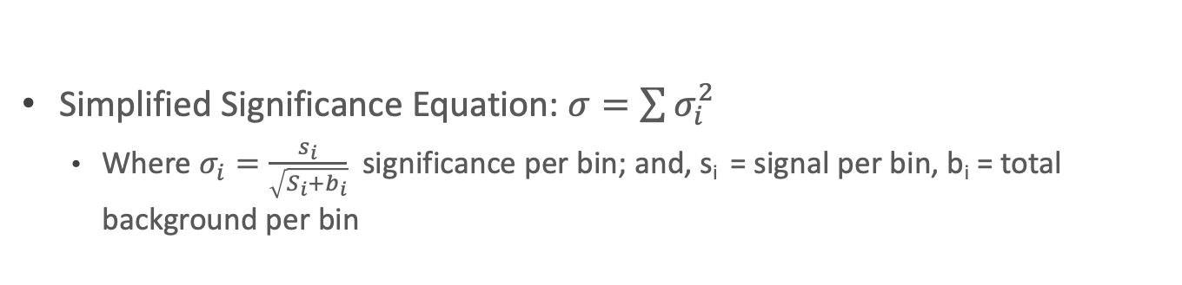
ggF HVTWZ (LP)
Significance study
Simplified Significance Equation: $σ=\sum{σ_{i}^{2}}$
Where $σ_{i}=\frac{s_{i}}{\sqrt{S_{i}+b_{i}}}$ significance per bin; and, s_{i} = signal per bin, b_{i} = total background per bin
ggF HVTWZ (HP)
Significance
Significance
Z’ Pole Mass [TeV]
Z’ Pole Mass [TeV]
Notes:
Probably tied to better resolution seen previously

Slide 45
ggF HVTWZ (combined LP/HP)
Significance study
Notes:
We hope to bring new improvements to the analysis

Slide 46
Previous analysis results
Paper: https://arxiv.org/abs/2004.14636
Drell-Yan production
VBF production
Observed (black solid curve) and expected (black dashed curve) 95% CL upper limits on the DY (left) and VBF (right) production cross-section of an HVT 𝑊’ boson at √ 𝑠 = 13 TeV in the 𝑊𝑍 decay mode as functions of its mass, combining searches in the three leptonic channels
Notes:
Exclusion limits plots
Production rate – higher the value the more you will produce
At 4 TEV we don’t have enough data to exclude the signal existing at that point
We hope this helps improve these previous results
The larger the cross section – the more likely we are to observe it
We want our signal to have a higher cross section than what we see – we are more likely to see it
If our signal cross section is smaller then our data, it will just be lost in the noise

Slide 47
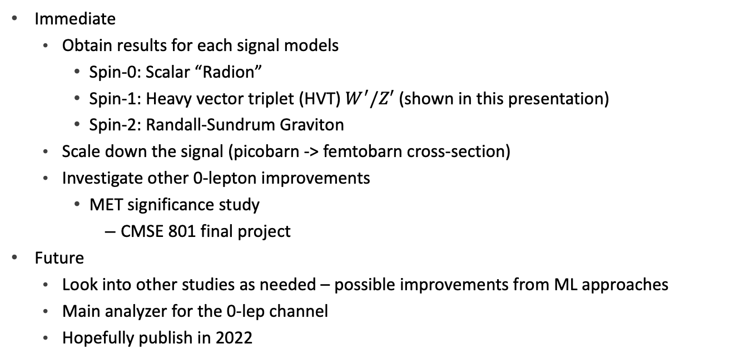
Next Steps
Immediate
Obtain results for each signal models
Spin-0: Scalar “Radion”
Spin-1: Heavy vector triplet (HVT) $W^{′}/Z′$ (shown in this presentation)
Spin-2: Randall-Sundrum Graviton
Scale down the signal (picobarn -> femtobarn cross-section)
Investigate other 0-lepton improvements
MET significance study
CMSE 801 final project
Future
Look into other studies as needed – possible improvements from ML approaches
Main analyzer for the 0-lep channel
Hopefully publish in 2022
Notes:
Main analyzer: I will be producing all Data/MC comparison plots for the paper (and any studies that need to be done for this channel)

Slide 48
Dilia Maria Portillo Quintero, DBL Workshop 2021. https://indico.cern.ch/event/1070672/ [Accessed October 16, 2021].

Slide 49
Background
η
$ΔR=\sqrt{Δη^{2}+Δφ^{2}}$
ΔR
z
ɸ
UCI Energy Blogs. https://sites.uci.edu/energyobserver/2012/11/26/introduction-to-the-atlas-detector-at-the-lhc/ [Accessed October 6, 2021].

Slide 50
Background
Running coupling constants
Notes:
Coupling constant measured the strength of the interaction
Think about how weak gravity is compared to EM
This constant depends on energy (mass)
When the coupling constants meet (merge) that means they are the same force

Slide 51
Motivation
Example of GUT that has failed
SU(5) → SU(3) x SU(2) x U(1) x U’(1)
False because requires the proton is unstable
We have evidence that the proton is stable
Current standard model
New particle
Notes:
The term graviton was originally coined in 1934 by Soviet physicists Dmitrii Blokhintsev and F.M. Gal'Perini

Slide 52
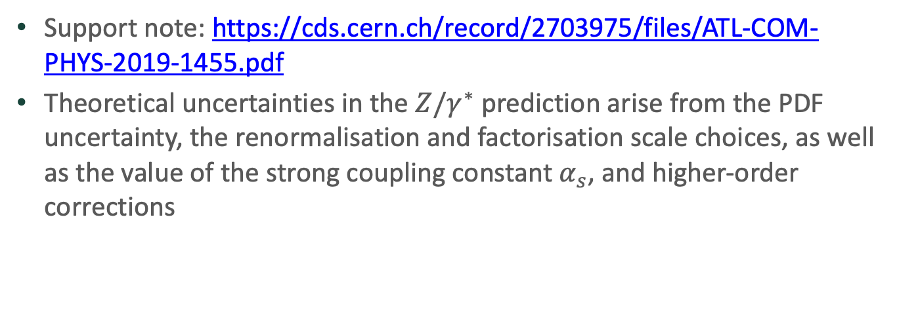
HMDY Theory Uncertainties
Support note: https://cds.cern.ch/record/2703975/files/ATL-COM-PHYS-2019-1455.pdf
Theoretical uncertainties in the $Z/γ^{∗}$ prediction arise from the PDF uncertainty, the renormalisation and factorisation scale choices, as well as the value of the strong coupling constant $α_{s}$, and higher-order corrections

Slide 53
HMDY Theory Uncertainties

Slide 54
Code and Documentation
GitHub repo for CxAODReader:
https://gitlab.cern.ch/CxAODFramework/CxAODReader_VVSemileptonic
Derivation: HIGG5D1 (0 lep-channel)
EasyTreePlotter:
https://gitlab.cern.ch/rles/easytreeplotter/-/blob/master/README.md
b-tagger
DL1r used for UFO
MV2c10 used for LCTTopo and TCC

Slide 55
Regions
Cuts
V - Control Region (VCR)
Fails invariant mass cut
Low Purity (LP)
Fails D₂^{(β=1)} requirement of boson tagging
High Purity (HP)
Passes D₂^{(β=1)} requirement of boson tagging
Signal Region (SR)
Passes invariant mass cut
Low Purity (LP)
Passes D₂^{(β=1)} requirement of boson tagging
High Purity (HP)
Fails D₂^{(β=1)} requirement of boson tagging

Slide 56
Cuts

Slide 57
Previous analysis results
0-lep invariant mass
Paper: https://arxiv.org/abs/2004.14636

Slide 58
Previous analysis results
Paper: https://arxiv.org/abs/2004.14636
Observed (black solid curve) and expected (black dashed curve) 95% CL upper limits on the (a) DY and (b) VBF production cross-section of an HVT Z’ boson at √ 𝑠 = 13 TeV in the 𝑊𝑊 decay mode as functions of its mass, combining searches in the three leptonic channels

Slide 59
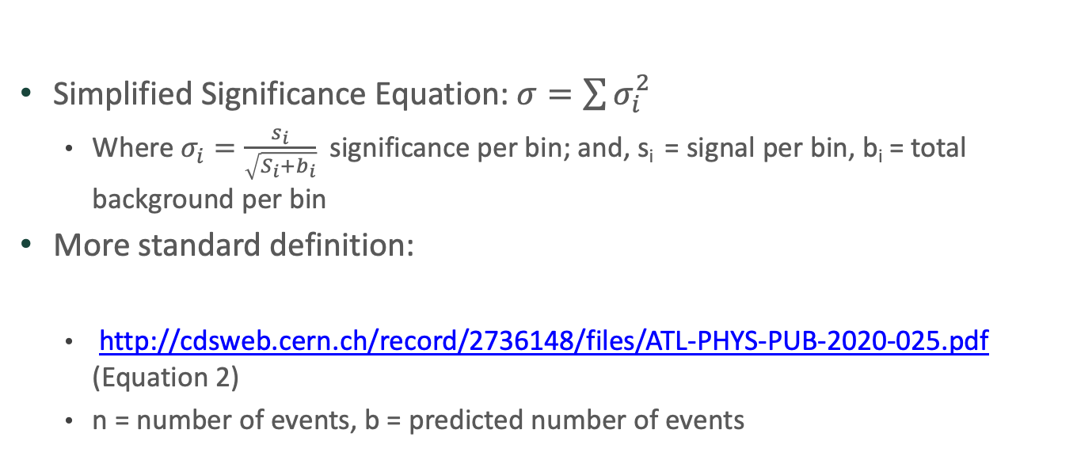
Significance
Simplified Significance Equation: $σ=\sum{σ_{i}^{2}}$
Where $σ_{i}=\frac{s_{i}}{\sqrt{S_{i}+b_{i}}}$ significance per bin; and, s_{i} = signal per bin, b_{i} = total background per bin
More standard definition:
http://cdsweb.cern.ch/record/2736148/files/ATL-PHYS-PUB-2020-025.pdf (Equation 2)
n = number of events, b = predicted number of events
Notes:
higher significance implying a better statistical power to observe such a signal

Slide 60
Definitions
Resolved
Two small R-jets
Merged
One large R-jet
Only merged used here
Jet substructure variable (D₂)
Large R-jet selection
Reconstructed by the energy correlation functions
Missing E_{T} (MET or E_{T}^{miss})
Reconstructed by negative sum of the all physics objects and ID tracks not associated with them

Slide 61
Motivation
Graviton
Hypothetical spin-2 particle that mediates the gravitational force
Notes:
The term graviton was originally coined in 1934 by Soviet physicists Dmitrii Blokhintsev and F.M. Gal'Perini

Slide 62
Definitions
Pre-selection
Very limited cuts to reduce the data size of the CxAOD’s
Zero reconstructed electrons/muons, some MET threshold, and one large-R jet
Signal Regions
Several stricter cuts than pre-selection, with one of those cuts requiring boson tagging.
Try to maximize signal, minimize background
Control Regions
Regions which look very similar to the signal region but have some slightly different selection to enrich a particular background (i.e. V boson), which is orthogonal to the signal region

